Slide 1
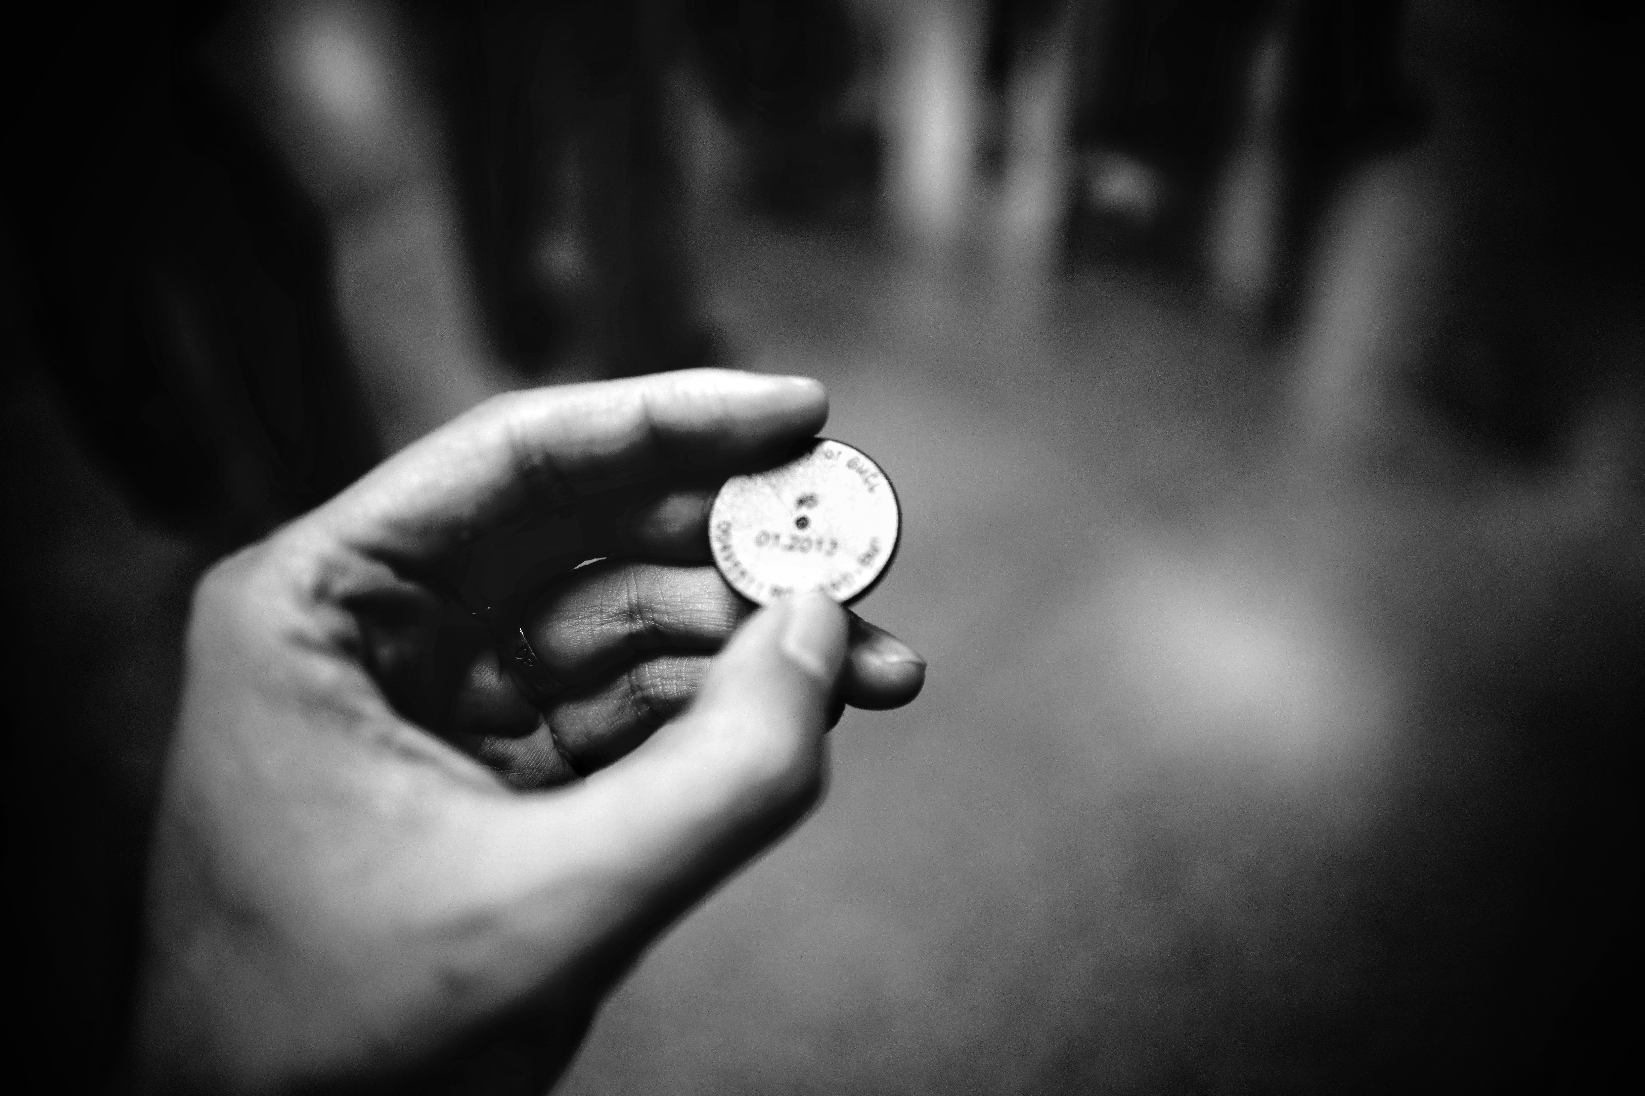
Tokenization Station

Slide 2
Opening Remarks
Save millions of dollars
Reduced risk of lawsuits and large fines
Reduced risk of bad public image of JPMorgan
Reduced risk of an attacker gaining access to personal data – Protecting our Customers!
Happy Customers – Happy Us!

